Slide 1
RSpec and OpenAPI

Slide 2
RSpec
If you can write Minitest tests, you can write RSpec specs: the ideas are the same, and mostly the words change
This guide maps what you know onto RSpec, using the Todo app's Item model and API

Slide 3
From TDD to BDD

Slide 4
BDD
BDD (behavior-driven development) is TDD with a change of focus: you describe what the code should do, not which method you're testing
The red, green, refactor cycle stays the same

Slide 5
BDD
Dan North coined the term around 2006. He found that the word "test" led people to ask the wrong questions: what to test, how much, and what to call a test
Writing each test as a sentence about behavior answered all three
Notes:
https://dannorth.net/blog/introducing-bdd/

Slide 6
BDD
What to test
  The next most important thing the code should do
How much
  One behavior per example
What to call it
  The sentence itself, like "is invalid without a what"

Slide 7
Given-When-Then
A structured template used in software development, Behavior-Driven Development (BDD), and acceptance testing to describe test cases and user stories in clear, understandable language

Slide 8
Given-When-Then
Given
  Sets up the initial context, state, or preconditions before the action happens
  E.g., “Given a user is logged into their account and has $50 in their wallet”
When
  Describes the specific action or trigger event that occurs
  E.g., “When the user clicks the ‘Buy Now’ button for a $20 item”
Then
  States the expected observable result or system behavior after the action
  E.g., “Then the user’s wallet balance should update to $30 and an order confirmation page should appear”

Slide 9
RSpec is built around that idea
Its words (describe, context, it, expect) are chosen so that a spec file reads like a specification

Slide 10
Testing

Slide 11
Minitest
require "test_helper"
class ItemTest < ActiveSupport::TestCase
test "valid with a what" do
item = Item.new(what: "Buy milk")
assert item.valid?
end
test "invalid without a what" do
item = Item.new(what: "")
assert_not item.valid?
assert_includes item.errors[:what], "can't be blank"
end
end

Slide 12
RSpec
require "rails_helper"
RSpec.describe Item do
describe "validations" do
it "is valid with a what" do
item = Item.new(what: "Buy milk")
expect(item).to be_valid
end
it "is invalid without a what" do
item = Item.new(what: "")
expect(item).not_to be_valid
expect(item.errors[:what]).to include("can't be blank")
end
end
end

Slide 13
Differences
The structure is the same: arrange, act, assert. Three things changed:
A block, not a class
  RSpec.describe Item do replaces class ItemTest < ActiveSupport::TestCase
it replaces test, and the description is written to follow "it"
  "it is valid with a what"
expect(...).to replaces assert
  expect(item).to be_valid

Slide 14
Minitest vs. RSpec
class ItemTest < ActiveSupport::TestCase
test "..." do
setup do
@item = ... in setup
assert x
assert_equal expected, actual
assert_nil x
assert item.valid?
assert_not item.valid?
assert_includes list, x
assert_difference "Item.count", 1 do
assert_raises(SomeError) do
assert_response :created
test/ and test_helper.rb
*_test.rb
bin/rails test
RSpec.describe Item do
it "..." do
before do
let(:item) { ... }
expect(x).to be_truthy
expect(actual).to eq(expected)
expect(x).to be_nil
expect(item).to be_valid
expect(item).not_to be_valid
expect(list).to include(x)
expect { ... }.to change(Item, :count).by(1)
expect { ... }.to raise_error(SomeError)
expect(response).to have_http_status(:created)
spec/ and rails_helper.rb
*_spec.rb
bundle exec rspec

Slide 15
describe names the thing under test: a class (describe Item) or a method
  By convention, "#when" means an instance method and ".create" a class method.
context names a situation, usually starting with "when" or "with": context "when no date is given"
it is one example
  one behavior, in one sentence.

Slide 16
RSpec.describe Item do
describe "#when" do # overloaded because of example
context "when no date is given" do
it "is nil" do
item = Item.new(what: "Buy milk")
expect(item.when).to be_nil
end
end
end
end

Slide 17
Reading
Read from the outside in, this says: "Item #when, when no date is given, is nil."

Slide 18
Let
RSpec.describe Item do
describe "#when" do
let(:item) { Item.new(what: "Buy milk", when: "2026-11-03") }
it "is stored as a Date" do
expect(item.when).to eq(Date.new(2026, 11, 3))
end
context "when no date is given" do
let(:item) { Item.new(what: "Buy milk") }
it "is nil" do
expect(item.when).to be_nil
end
end
end
end

Slide 19
Let Details
It's lazy
  The block runs the first time an example uses item, not before
  An example that never mentions item never builds one
It's memoized per example
  Within one example, item is the same object every time
  Each new example gets a fresh one, so examples can't leak state into each other.
An inner group can override it
  The context above redefines item for its own examples only
  That's how one spec file covers several situations without repeating the setup.

Slide 20
Expect and Matching
Every expectation has the same shape: expect(actual).to matcher, or .not_to matcher

Slide 21
Example Matchers
eq expect(item.what).to eq("Buy milk")
be_nil expect(item.when).to be_nil
be_valid expect(item).to be_valid
Include expect(item.errors[:what]).to include("can't be blank")
match expect(response.content_type).to match(/json/)
change expect { Item.create(what: "Buy milk") }.to change(Item, :count).by(1)
raise_error expect { item.save! }.to raise_error(ActiveRecord::RecordInvalid)
have_http_status expect(response).to have_http_status(:created)

Slide 22
Running
bundle exec rspec
bundle exec rspec spec/models/item_spec.rb
bundle exec rspec spec/models/item_spec.rb:10
bundle exec rspec --format documentation

Slide 23
What is OpenAPI?
The OpenAPI Specifications provide a formal standard for describing HTTP APIs.
This allows people to understand how an API works, how a sequence of APIs work together, generate client code, create tests, apply design standards, and more.
Notes:
https://www.openapis.org/

Slide 24
Wikipedia
The OpenAPI Specification (OAS), previously known as the Swagger Specification, is a specification for a machine-readable interface definition language for describing, producing, consuming and visualizing web services

Slide 25
JSON and YAML Compatibility
In order to preserve the ability to round-trip between YAML and JSON formats, YAML version 1.2 is RECOMMENDED
Notes:
https://spec.openapis.org/oas/latest.html

Slide 26
Add the Gems
bundle add rspec-rails rspec-openapi --group "development,test"

Slide 27
Generate RSpec
 bin/rails g rspec:install
create .rspec
create spec
create spec/spec_helper.rb
create spec/rails_helper.rb

Slide 28
Create the App
./bin/rails g scaffold Item what:string when:date
./bin/rails db:migrate

Slide 29
Deal with File Collision
mv spec/requests/items_spec.rb spec/requests/items_html_spec.rb

Slide 30
Generate RSpec Tests
 ./bin/rails g rspec:scaffold Item what:string when:date --api --no-routing-specs
create spec/requests/items_spec.rb

Slide 31
Generates a Bunch of Tests
spec/helpers/items_helper_spec.rb
spec/models/item_spec.rb
spec/requests/items_html_spec.rb
spec/requests/items_spec.rb
spec/routing/items_routing_spec.rb
spec/views/items/edit.html.erb_spec.rb
spec/views/items/index.html.erb_spec.rb
spec/views/items/new.html.erb_spec.rb
spec/views/items/show.html.erb_spec.rb

Slide 32
Move the Files Back
mv spec/requests/items_spec.rb spec/requests/items_api_spec.rb
mv spec/requests/items_html_spec.rb spec/requests/items_spec.rb

Slide 33
Fix the Skips
--- a/spec/requests/items_api_spec.rb
+++ b/spec/requests/items_api_spec.rb
@@ -17,11 +17,11 @@ RSpec.describe "/items", type: :request do
# Item. As you add validations to Item, be sure to
# adjust the attributes here as well.
let(:valid_attributes) {
- skip("Add a hash of attributes valid for your model")
+ { what: "Buy milk", when: "2026-11-03" }
}
let(:invalid_attributes) {
- skip("Add a hash of attributes invalid for your model")
+ { what: "" }
}

Slide 34
# This should return the minimal set of values that should be in the headers
@@ -85,7 +85,7 @@ RSpec.describe "/items", type: :request do
describe "PATCH /update" do
context "with valid parameters" do
let(:new_attributes) {
- skip("Add a hash of attributes valid for your model")
+ { what: "Buy oat milk" }
}

Slide 35
it "updates the requested item" do
@@ -93,7 +93,7 @@ RSpec.describe "/items", type: :request do
patch item_url(item),
params: { item: new_attributes }, headers: valid_headers, as: :json
item.reload
- skip("Add assertions for updated state")
+ expect(item.what).to eq("Buy oat milk")
end

Slide 36
Create pubic/api-docs.html
<!DOCTYPE html>
<html lang="en">
<head>
<meta charset="utf-8">
<title>Todo API</title>
<link rel="stylesheet" href="https://unpkg.com/swagger-ui-dist@5.17.14/swagger-ui.css">
</head>
<body>
<div id="swagger-ui"></div>
<script src="https://unpkg.com/swagger-ui-dist@5.17.14/swagger-ui-bundle.js"></script>
<script>
SwaggerUIBundle({ url: "/openapi.yaml", dom_id: "#swagger-ui" });
</script>
</body>
</html>

Slide 37
Little Fixes
--- a/app/controllers/items_controller.rb
+++ b/app/controllers/items_controller.rb
@@ -1,5 +1,6 @@
class ItemsController < ApplicationController
before_action :set_item, only: %i[ show edit update destroy ]
+ protect_from_forgery with: :null_session, if: -> { request.format.json? }
# GET /items or /items.json
def index

Slide 38
--- a/app/models/item.rb
+++ b/app/models/item.rb
@@ -1,2 +1,3 @@
class Item < ApplicationRecord
+ validates :what, presence: true
end

Slide 39
--- a/spec/rails_helper.rb
+++ b/spec/rails_helper.rb
@@ -70,3 +70,6 @@ RSpec.configure do |config|
# arbitrary gems may also be filtered via:
# config.filter_gems_from_backtrace("gem name")
end
+RSpec::OpenAPI.path = "public/openapi.yaml"
+RSpec::OpenAPI.title = "Todo API"
+RSpec::OpenAPI.openapi_version = "3.1.0"

Slide 40
--- a/spec/requests/items_spec.rb
+++ b/spec/requests/items_spec.rb
@@ -12,7 +12,7 @@ require 'rails_helper'
# of tools you can use to make these specs even more expressive, but we're
# sticking to rails and rspec-rails APIs to keep things simple and stable.
-RSpec.describe "/items", type: :request do
+RSpec.describe "/items", type: :request, openapi: false do

Slide 41
--- a/spec/views/items/index.html.erb_spec.rb
+++ b/spec/views/items/index.html.erb_spec.rb
@@ -14,7 +14,7 @@ RSpec.describe "items/index", type: :view do
it "renders a list of items" do
render
- cell_selector = 'div>p'
+ cell_selector = 'div>div>div'
assert_select cell_selector, text: Regexp.new("What".to_s), count: 2
end

Slide 42
$ bundle exec rspec
**...................................
Pending: (Failures listed here are expected and do not affect your suite's status)
1) ItemsHelper add some examples to (or delete) /private/tmp/Todo/spec/helpers/items_helper_spec.rb
# Not yet implemented
# ./spec/helpers/items_helper_spec.rb:14
2) Item add some examples to (or delete) /private/tmp/Todo/spec/models/item_spec.rb
# Not yet implemented
# ./spec/models/item_spec.rb:4
Finished in 0.78183 seconds (files took 6.6 seconds to load)
37 examples, 0 failures, 2 pending

Slide 43
Okay, Now We're Testing
And here comes the cool part
rspec/OpenAPI uses those tests to create the YAML by monitoring the request tests
Generates public/openapi.yaml

Slide 44
$ OPENAPI=1 bundle exec rspec
**...................................
Pending: (Failures listed here are expected and do not affect your suite's status)
1) ItemsHelper add some examples to (or delete) /private/tmp/Todo/spec/helpers/items_helper_spec.rb
# Not yet implemented
# ./spec/helpers/items_helper_spec.rb:14
2) Item add some examples to (or delete) /private/tmp/Todo/spec/models/item_spec.rb
# Not yet implemented
# ./spec/models/item_spec.rb:4
Finished in 1.04 seconds (files took 3.55 seconds to load)
37 examples, 0 failures, 2 pending

Slide 45
Swagger UI Page
http://localhost:3000/api-docs

Slide 46
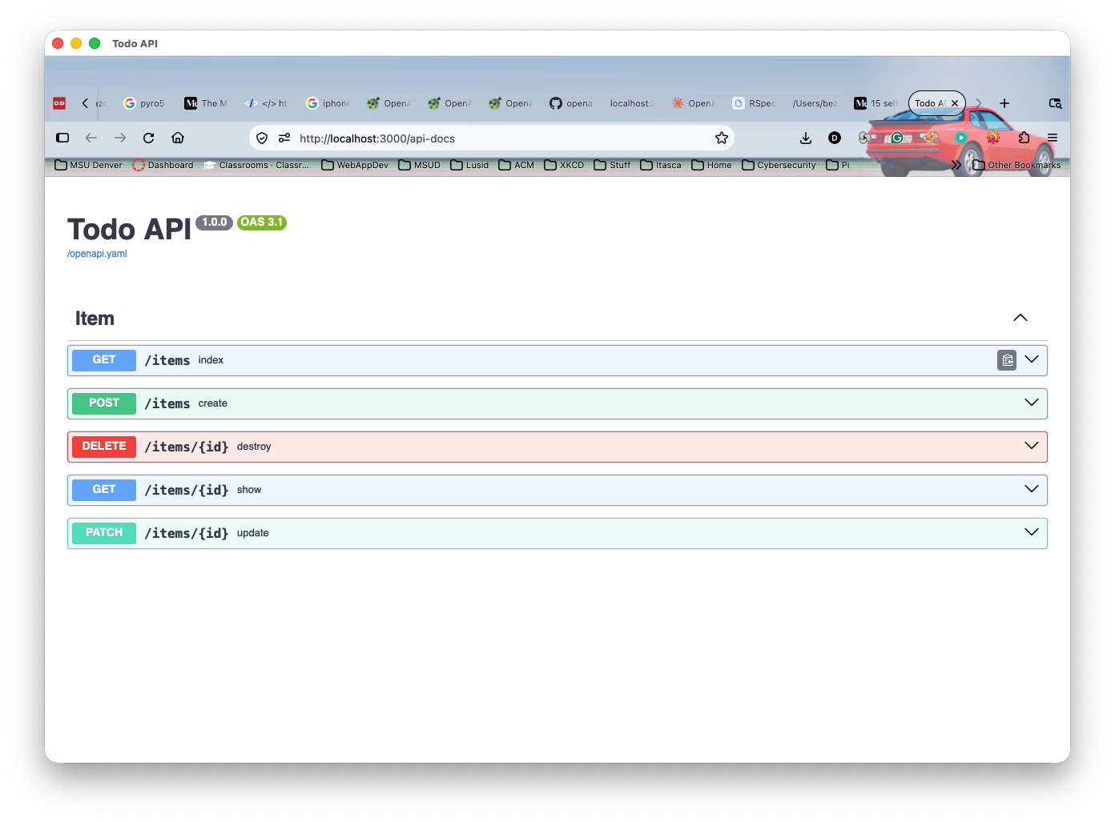

Slide 47
OpenAPI YAML
http://localhost:3000/openapi.yaml

Slide 48
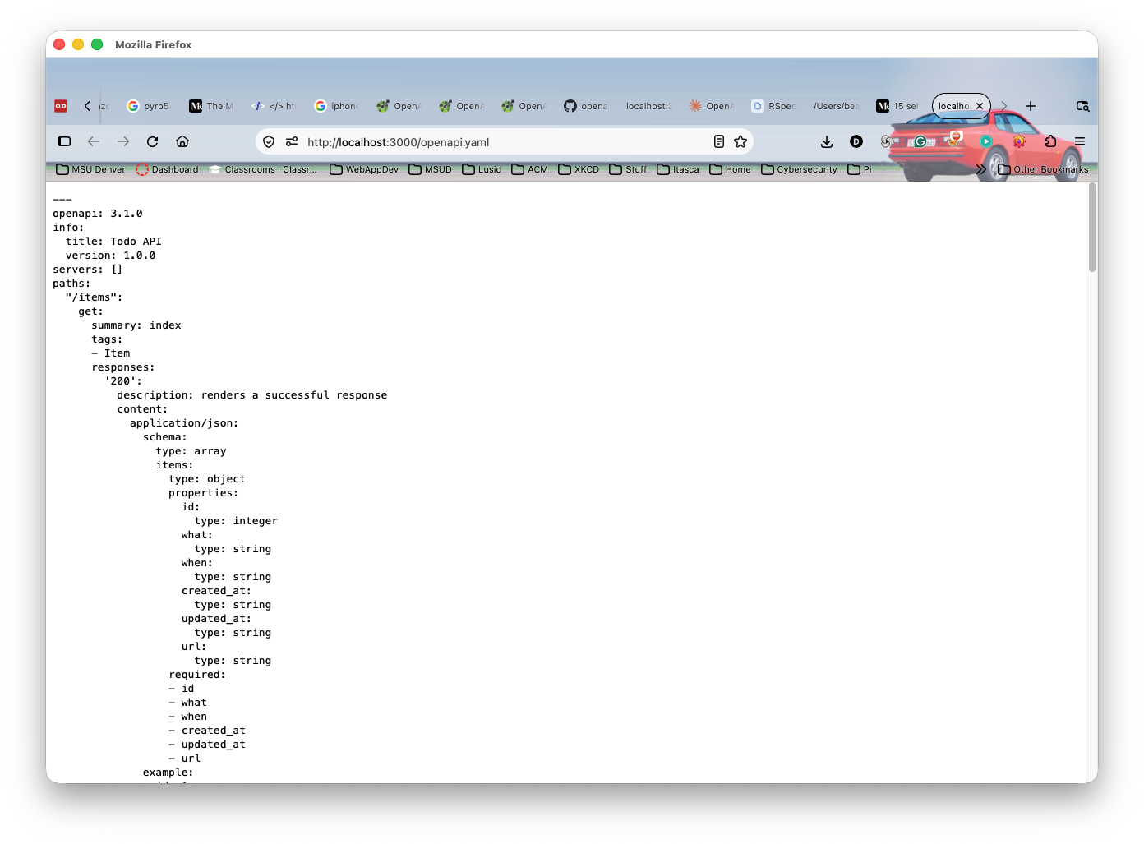

Slide 49
OpenAPI-Ruby
https://github.com/openapi-ruby/openapi-ruby
Takes a different approach
  We create the YAML
  It tests to make sure our app complies

